Slide 1

Reproducible Clinical Data Analysis with R and RStudio
Welcome to
Wireless network: PennMedicine

Slide 2
Reproducible Clinical Data Analysis with R and RStudio
Welcome to
Interactive R Command Prompt
Wireless network: PennMedicine

Slide 3
Reproducible Clinical Data Analysis with R and RStudio
Welcome to
Editable
Notebook
Data
Overview
Interactive R Command Prompt
Wireless network: PennMedicine

Slide 4
Reproducible Clinical Data Analysis with R and RStudio
Welcome to
Editable
Notebook
Data
Overview
Interactive R Command Prompt
Wireless network: PennMedicine

Slide 5
Reproducible Clinical Data Analysis with R and RStudio
Welcome to
Editable
Notebook
Data
Overview
Interactive R Command Prompt
Rendered Reproducible Report
Wireless network: PennMedicine

Slide 6
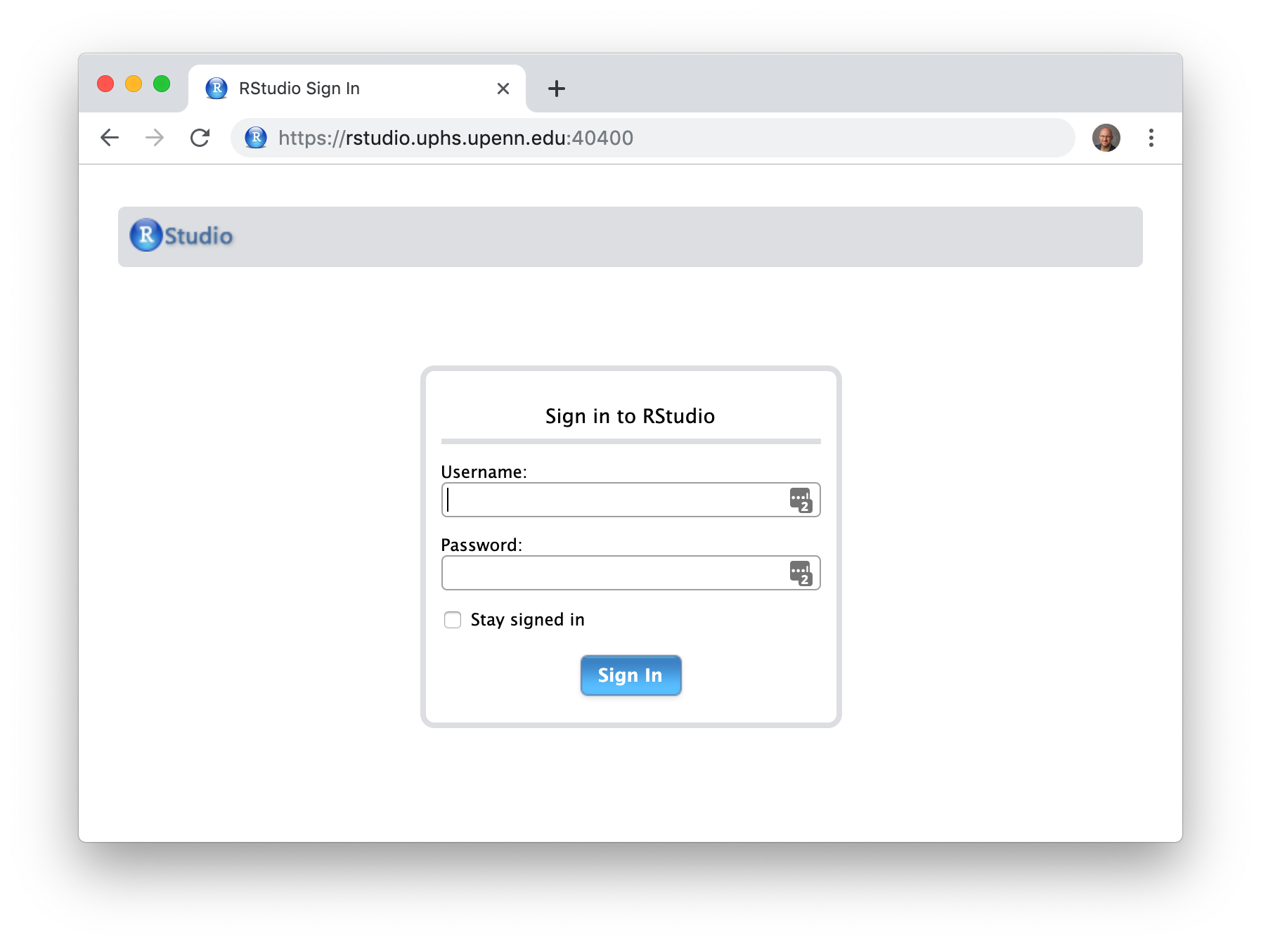
Reproducible Clinical Data Analysis with R and RStudio
Welcome to
Step 1. Browse to https://rstudio.uphs.upenn.edu:40400
Wireless network: PennMedicine

Slide 7
Reproducible Clinical Data Analysis with R and RStudio
Welcome to
Step 2. Login using your UPHS login and the password given to you by the instructors
Username (UPHS)
Password
(provided by instructors)
Wireless network: PennMedicine

Slide 8
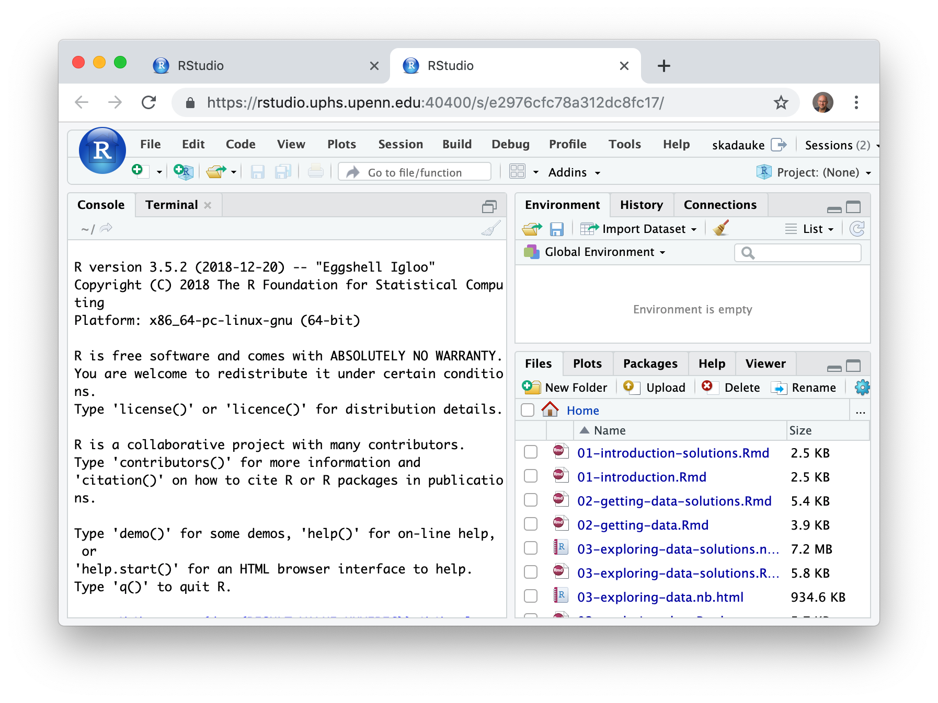
Reproducible Clinical Data Analysis with R and RStudio
Welcome to
Step 3. Click on the Terminal tab
Terminal tab
Wireless network: PennMedicine

Slide 9
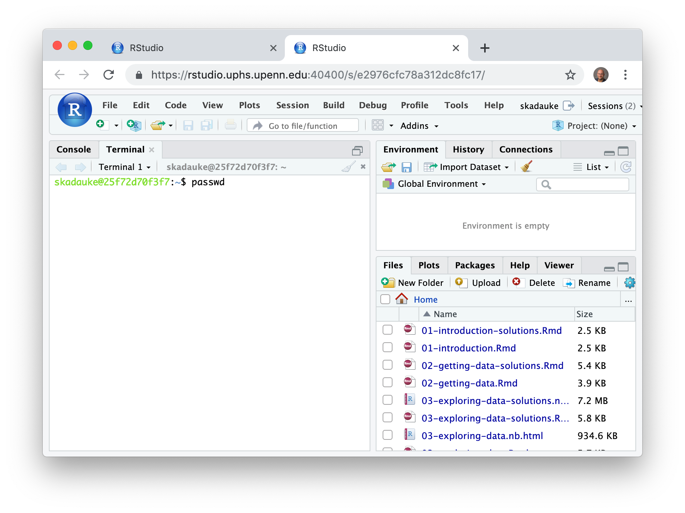
Reproducible Clinical Data Analysis with R and RStudio
Welcome to
Step 4. Type passwd (and hit enter) to change your password.
Wireless network: PennMedicine

Slide 10
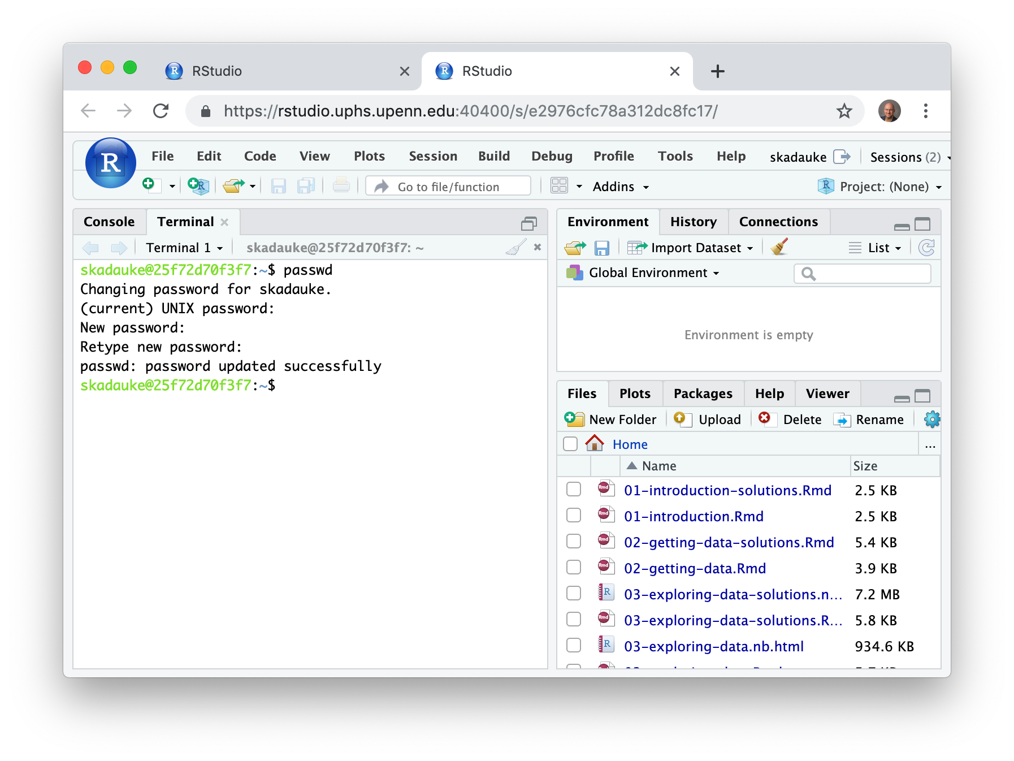
Reproducible Clinical Data Analysis with R and RStudio
Welcome to
Step 5. Make sure your password is updated successfully.
”Password updated successfully”
Wireless network: PennMedicine

